Slide 1




Modelling Public Transport Accessibility and Commuting Inequality
A Generalised Cost Approach for Cardiff University Staff
Motivation
accessibility gaps in sustainable staff commuting.
Cost and reliability are key barriers to modal shift.
How can commuting burden be quantified more realistically?
Research Aim
To quantify public transport commuting burden.
Relation to deprivation and SOC driving?

Slide 2








Methodological Framework
Cardiff study area: 229 LSOAs; final matched sample: 840 staff across 191 LSOAs
STEP 02
STEP 04
STEP 06
Prepare Survey Data
Model Public Transport Routes
Analysis
Define Spatial Framework
Integrate GIS + WIMD Data
Construct Generalised Cost Index
STEP 01
STEP 03
STEP 05

Slide 3
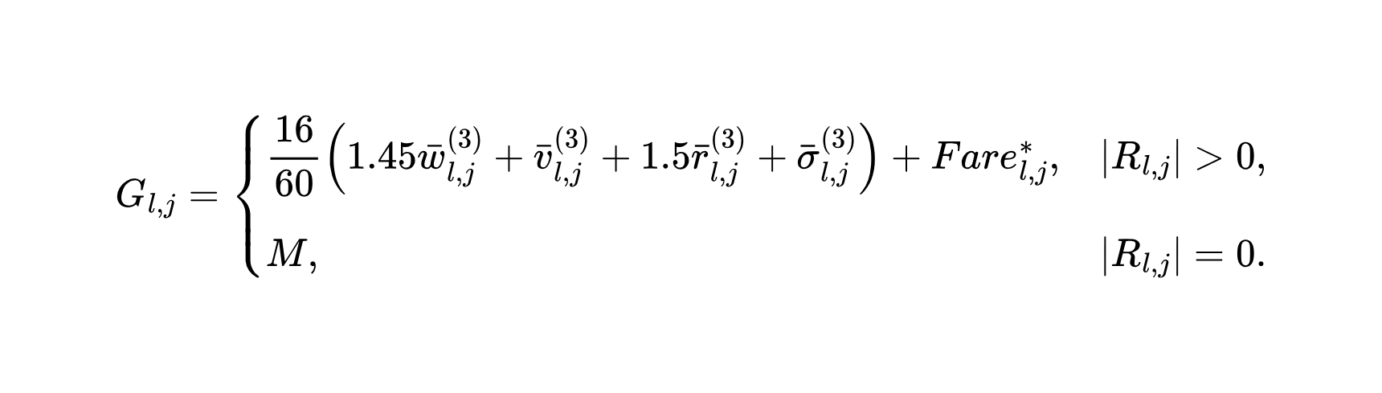
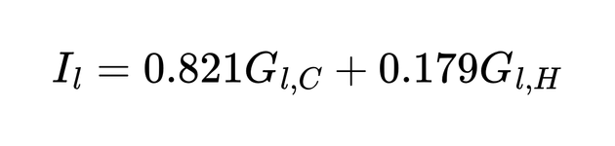
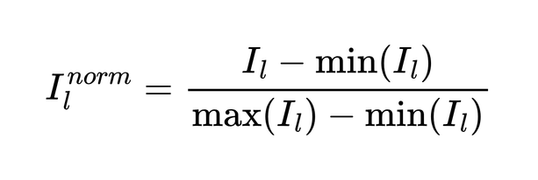
Building the Gerneralised Accessibility Cost Index
Campus-specific generalised cost:
Campus-weighted accessibility index:
Normalised index:

Slide 4
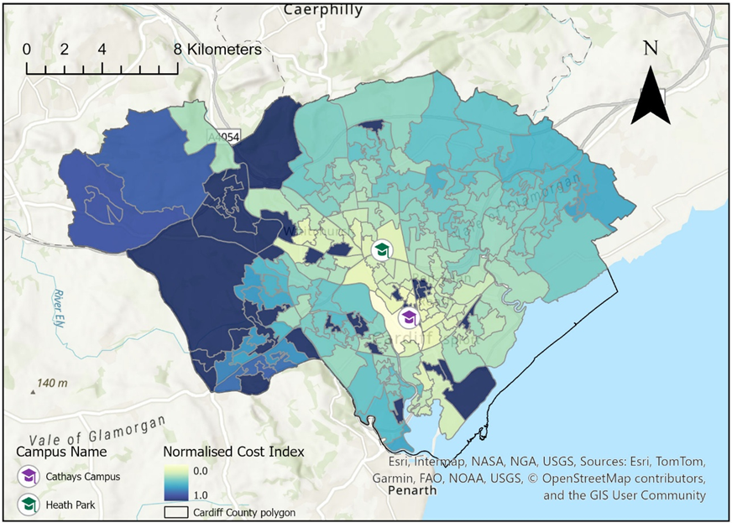
Spatial Distribution of Accessibility Cost
£14.90 vs £12.59
Figure 1. Spatial distribution of the normalised accessibility cost index across Cardiff LSOAs, with campus locations)

Slide 5

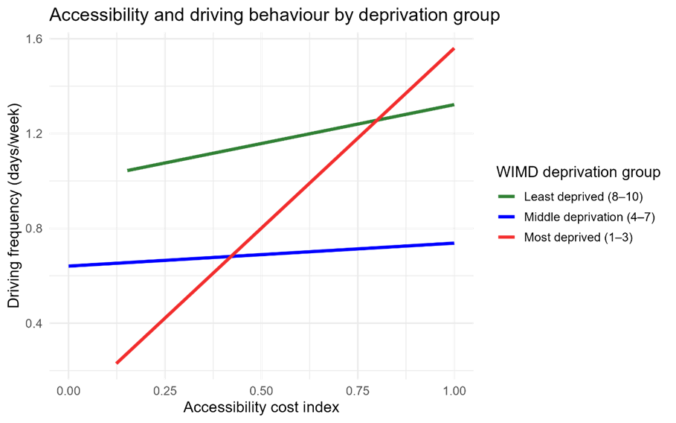
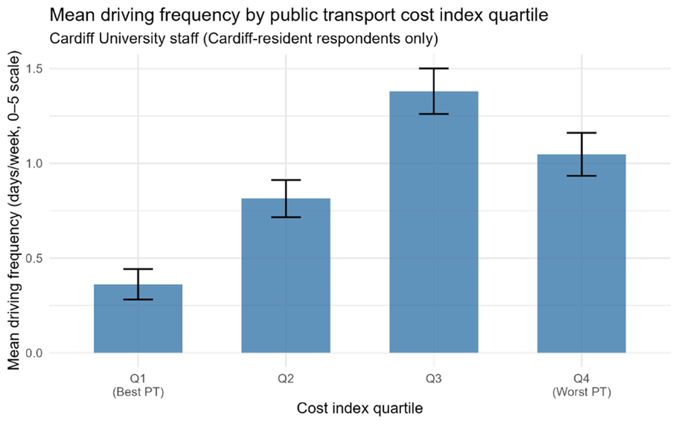
Accessibility Cost, Deprivation and Car Use
Key results
Overall relationship was positive but modest:
Accessibility cost had the strongest association with SOC.
Figure 2. Interaction plot of accessibility cost and driving frequency by deprivation band.
Figure 3. Mean driving frequency by accessibility cost quar-
tile, with standard error bar

Slide 6


Conclusions, Contribution and Limitations
Contribution
Built a route-based generalised cost index.
Index outperforms simple measures.
Heath Park has higher cost.
Higher cost -> SOC driving
Limitations
Not live journey data.
Small sample frame.
Future research:
Real-time transport data
Longtitudinal analysis
Individual constraints
Overall: Sustainable travel policy should reduce actual journey burden, not just increase transport provision.

